Slide 1
Transforming Health Insurance: A Personalized Approach
Aashi Sethiya
Rachel Rittmeyer
Nydasia Gray
Savannah Berntson
Corey Pein

Slide 2
Use Case
We're addressing the limitations of traditional health insurance by offering personalized plans based on individual health profiles. Using data from Fitbit devices, we tailor insurance to each person's lifestyle and health metrics. Our platform uses advanced analytics to empower users with informed decision-making and continuous monitoring. Features include risk profiling, dynamic premium calculation, and proactive health management. This approach aims to improve coverage, reduce costs, and promote well-being among policyholders.

Slide 3
Business Rules
sleep Table
Description: Contains information regarding user’s sleep and time in bed based on their activity levels.
Relationship: One-to-one relationship with the basal_metabolic_rate_factors table through user_id as all of the user's sleep information is tracked together.
daily_activity Table
Description: Calculates total calories burned for the user’s activity levels from the day.
Relationship: One-to-one relationship with the basal_metabolic_rate_factors table through user_id to track individual activity information per user.
weight_log Table
Description: Contains the weight and height information for each user.
Relationship: One-to-one relationship through user_id with the basal_metabolic_rate_factors table, users can only have one weight and height per person.
Our platform relies on several key tables to store and utilize health data and user information. Understanding the relationships and business rules associated with these tables is essential for providing personalized health insurance plans.

Slide 4
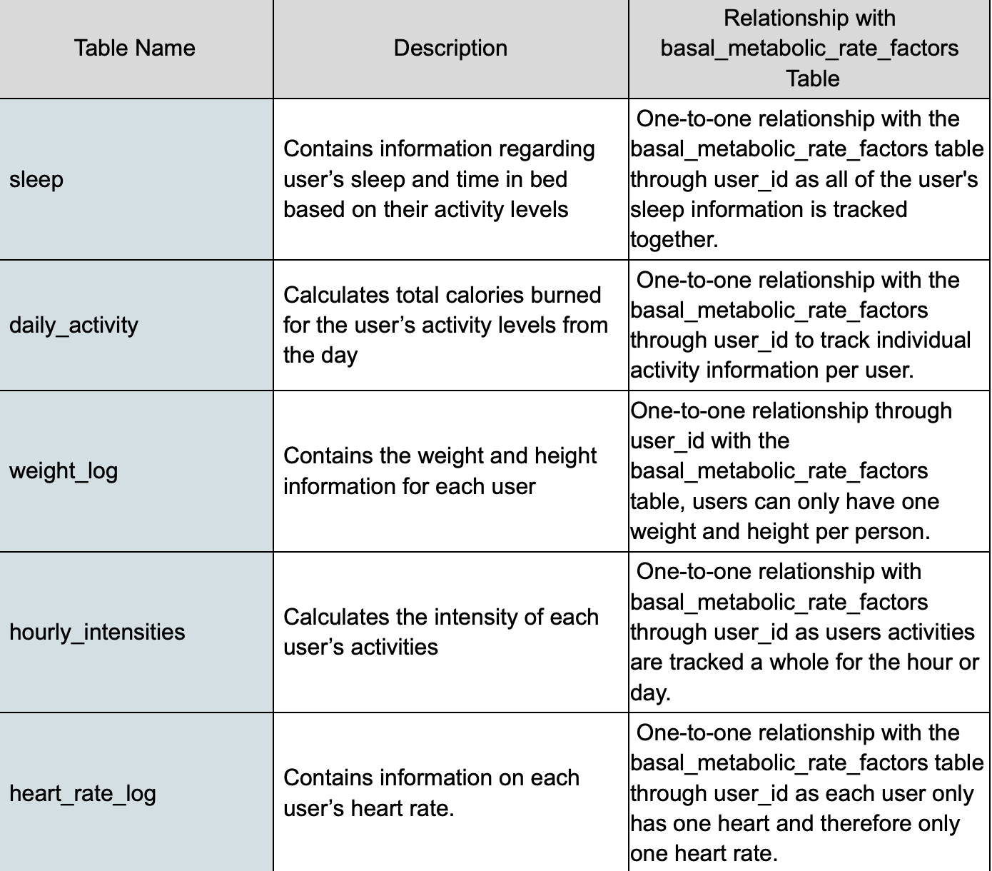
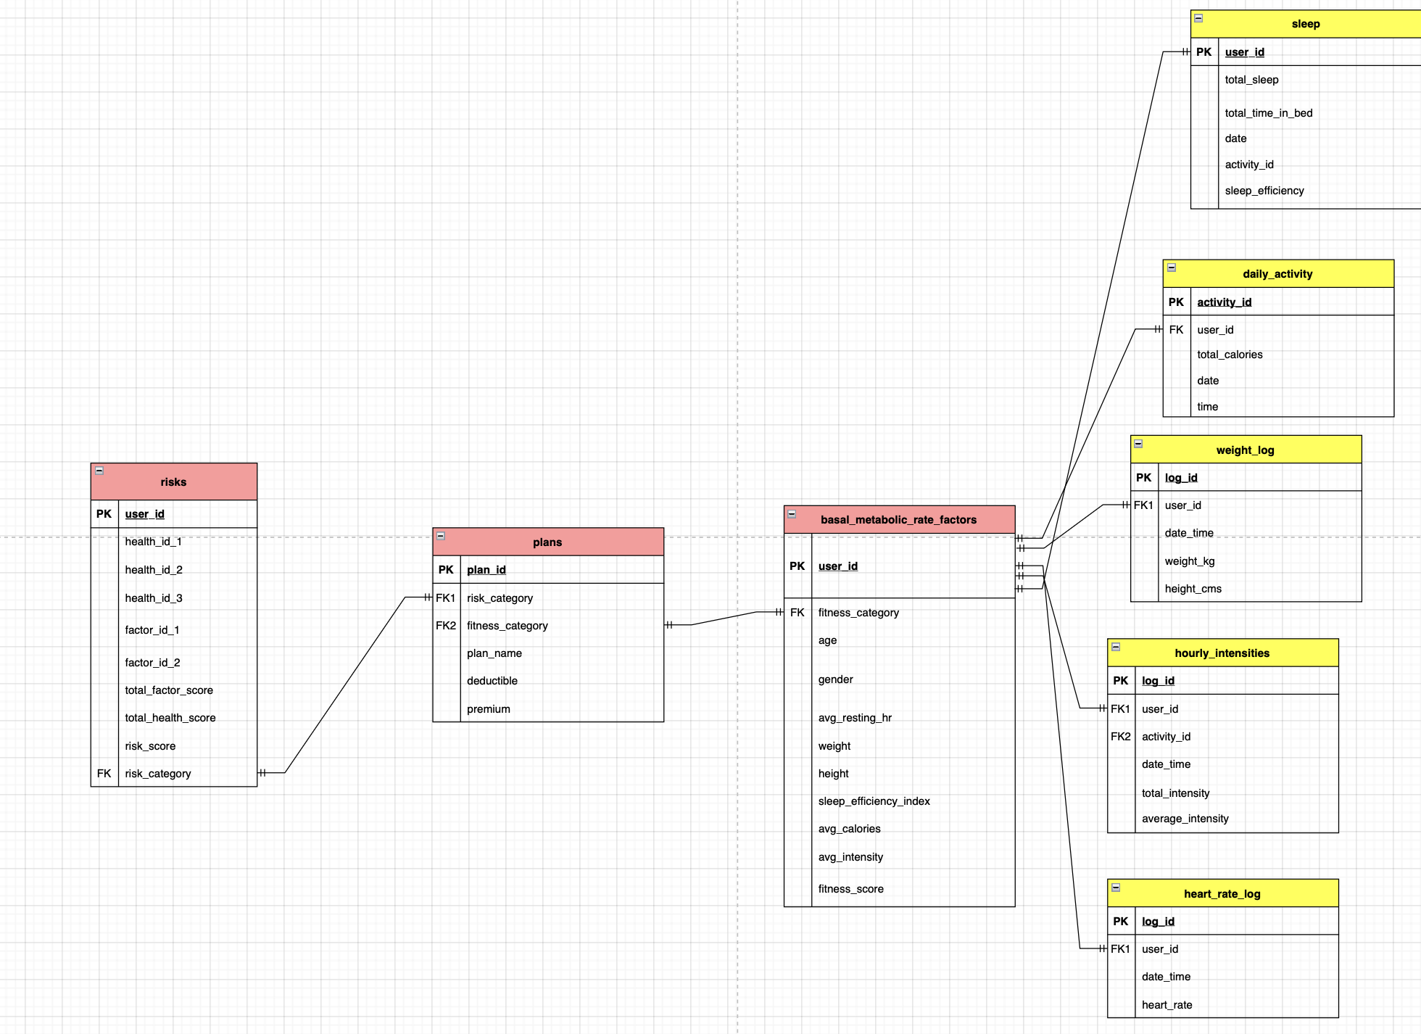
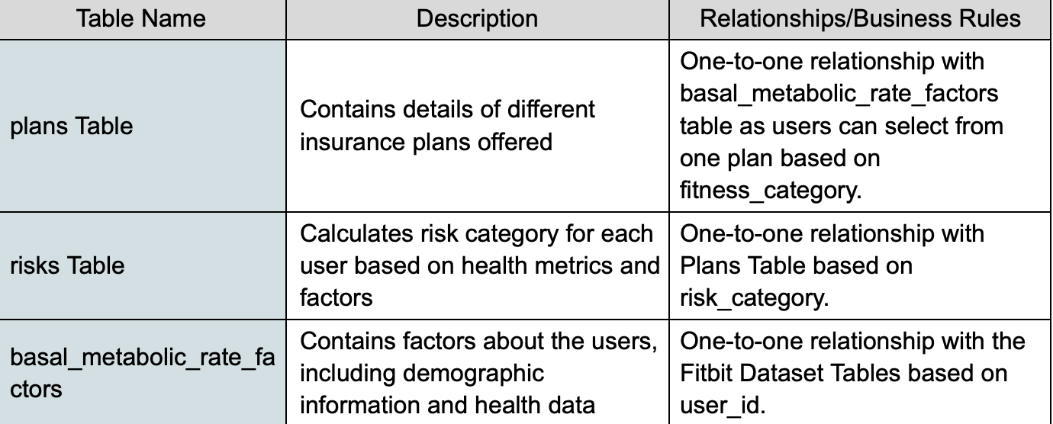
ERD and Key Entities
The Basal Metabolic Factor tables holds the user_id and holds the most relationships with other tables. Risks, plans, sleep, daily_activity, weight_log, hourly_intensities, and heart_rate_log are the entities with the factors below as their attributes.
Talk about the entities

Slide 5
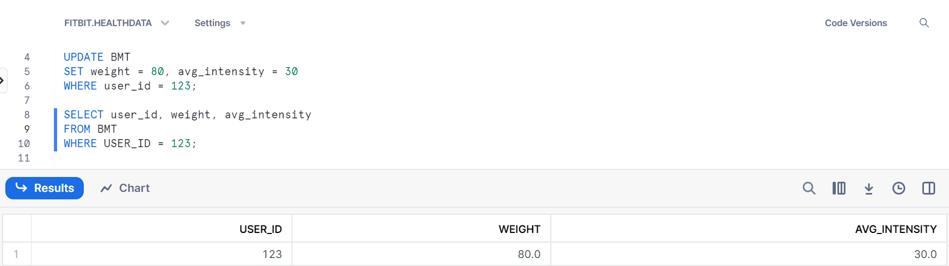
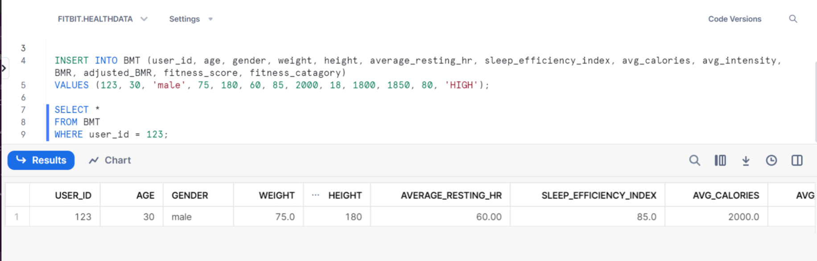
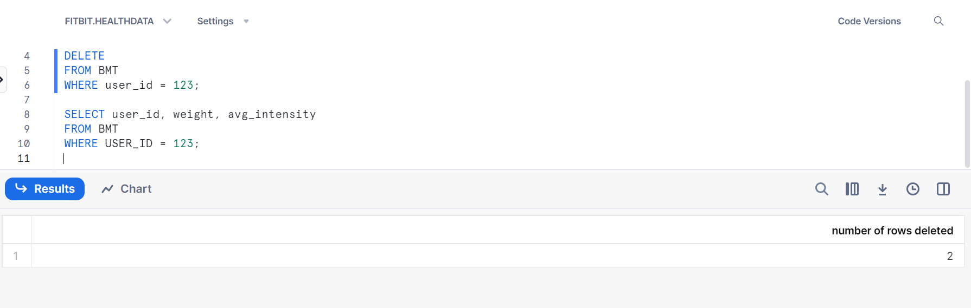
Insert Update Delete
-> This procedure updates the weight and average intensity recorded in the Body Measurement Table for the user with the ID 123. These updated values reflect the user’s current body measurements and activity level.
^ This procedure inserts two sets of data for the same user into the ‘BMT’ table. The first set contains basic measurements such as age, gender, weight, height and average calories; while the second set contains additional measurements and classification information.
^ This procedure deletes existing records for a specified user from the BMT table and then selects the user’s weight and average intensity data.

Slide 6
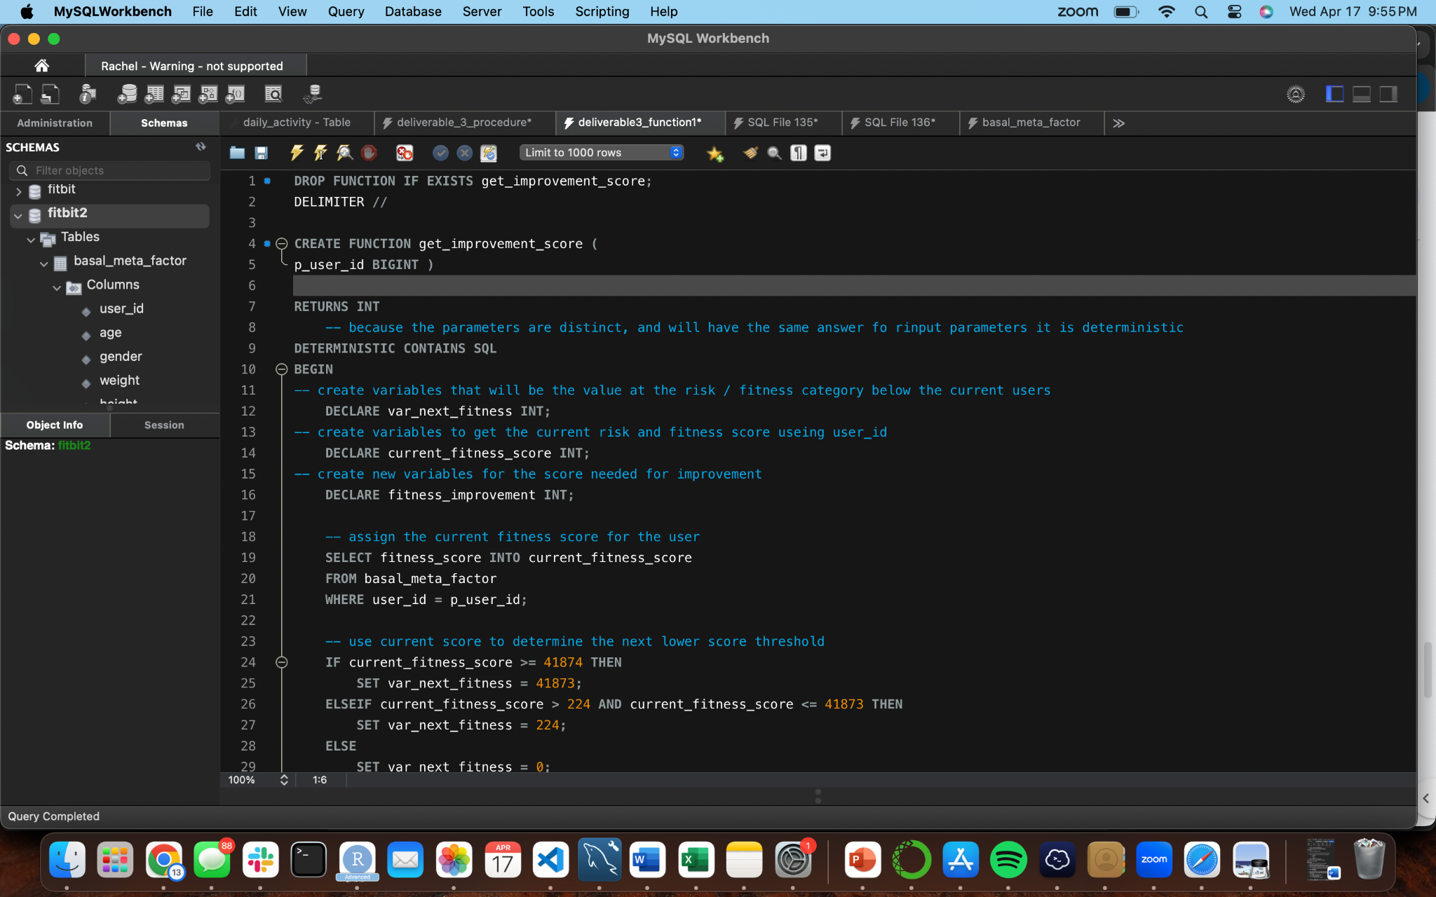
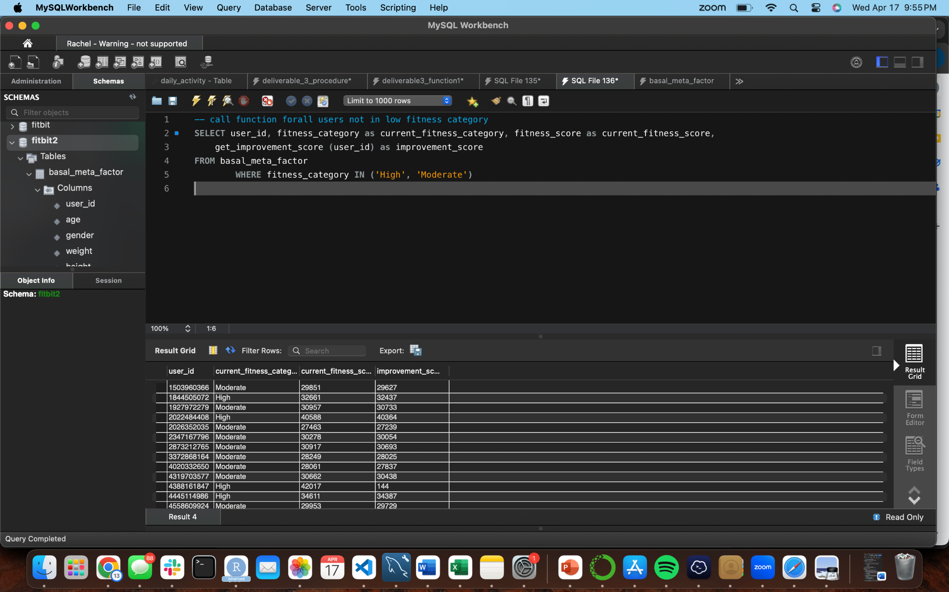
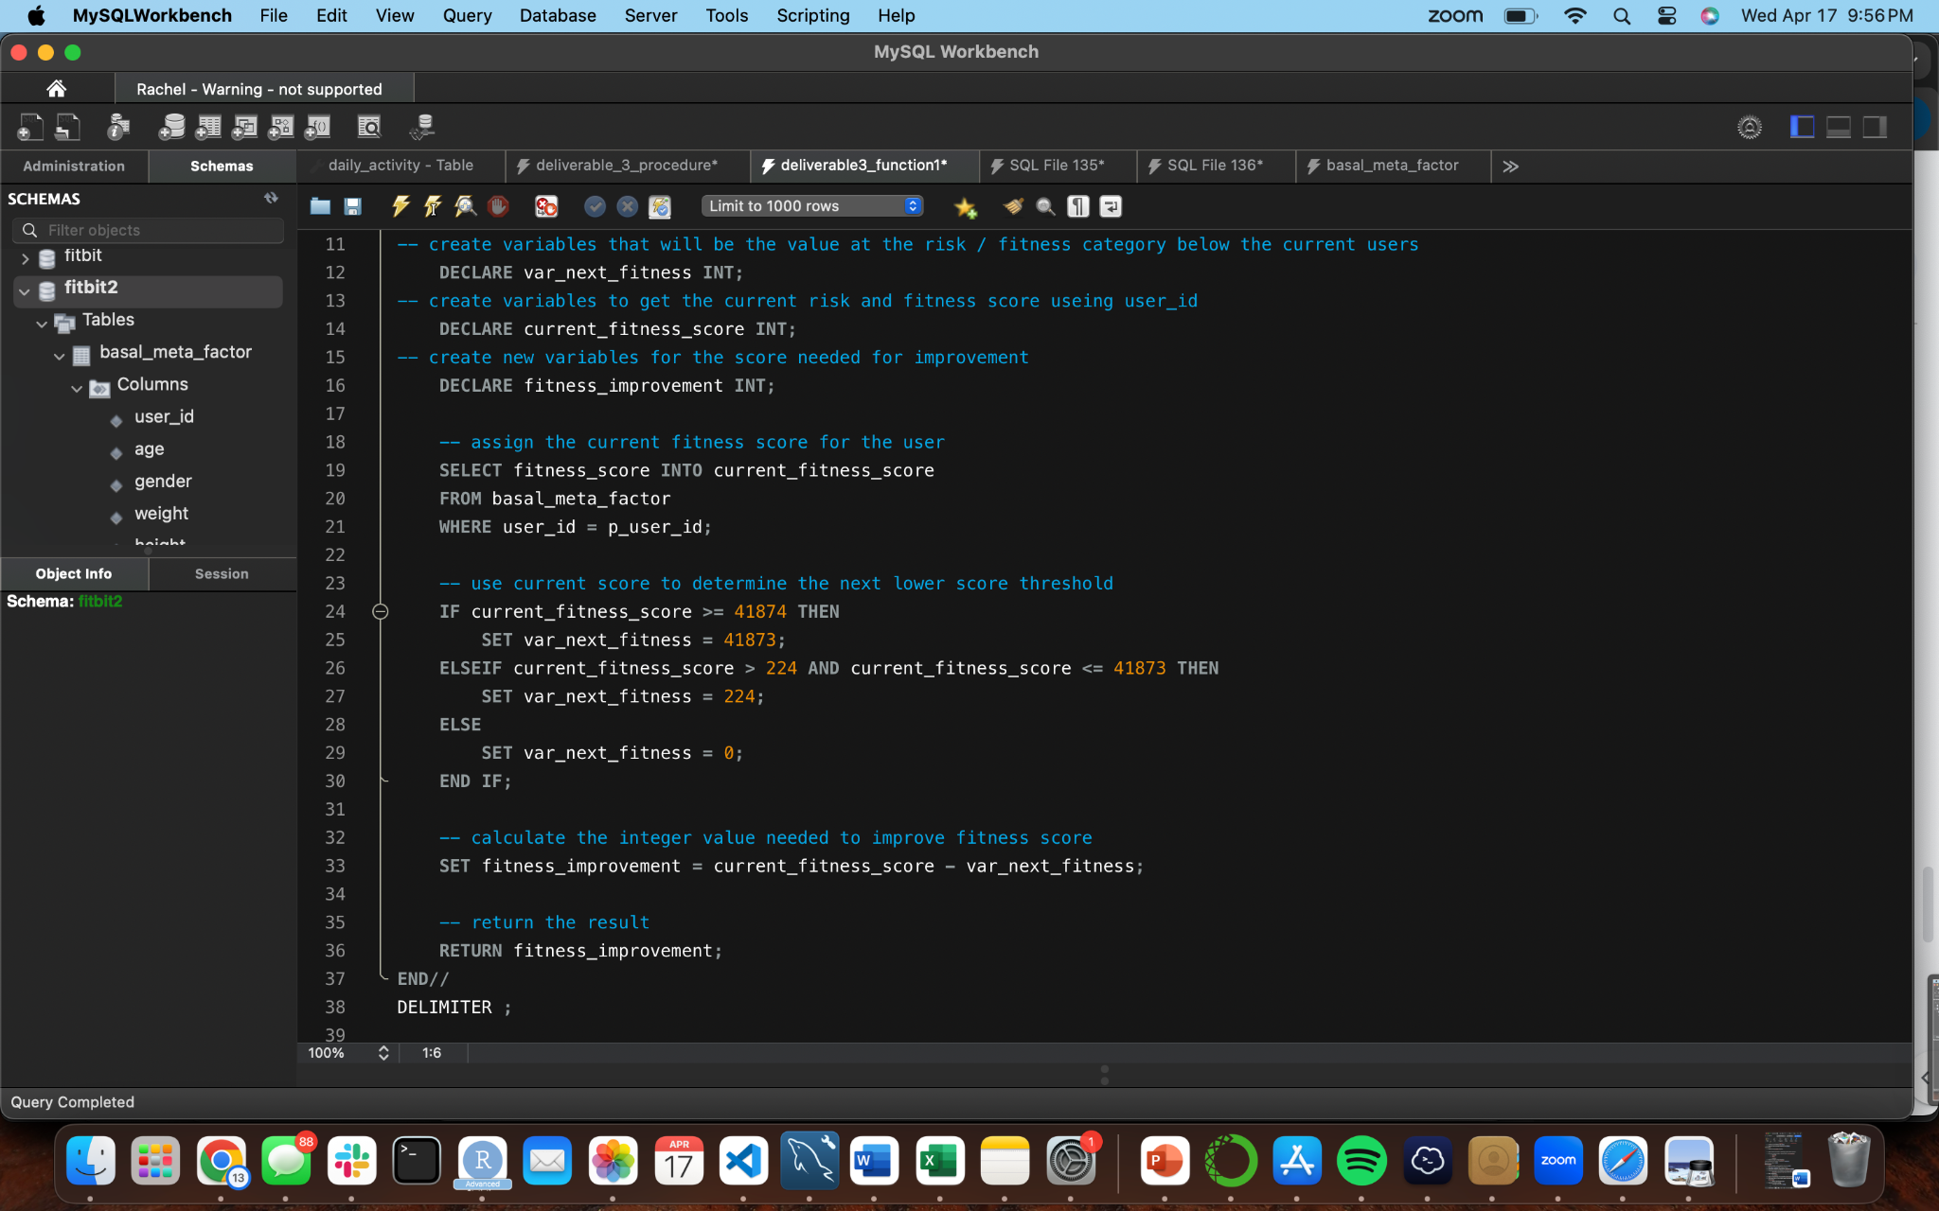
Function: get_improvement_score
This function calculates the improvement score needed for a user’s fitness category based on their current fitness score.

Slide 7
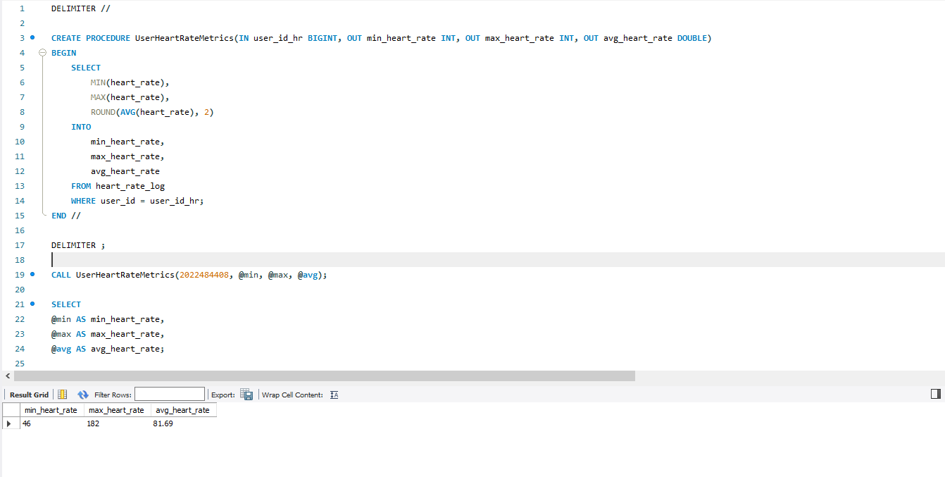
Stored Procedure
This procedure calculates the minimum, maximum and average heart rates for a specific user based on their user ID. It retrieves this information from the ‘heart_rate_log’ table and assigns the results to output parameters ‘min_heart_rate’, ‘max_heart_rate’ and ‘avg_heart_rate’.

Slide 8
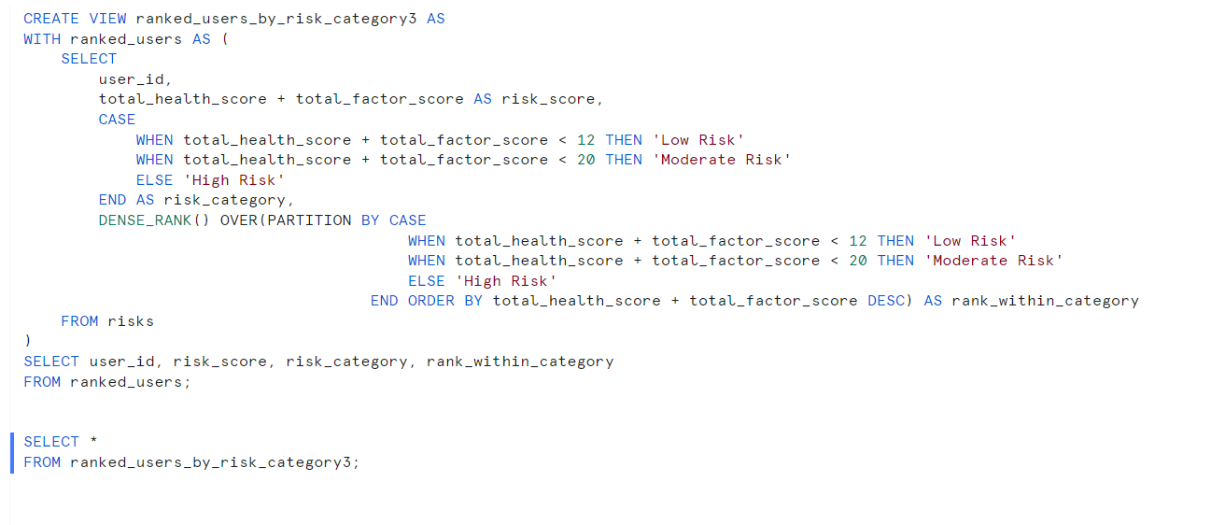
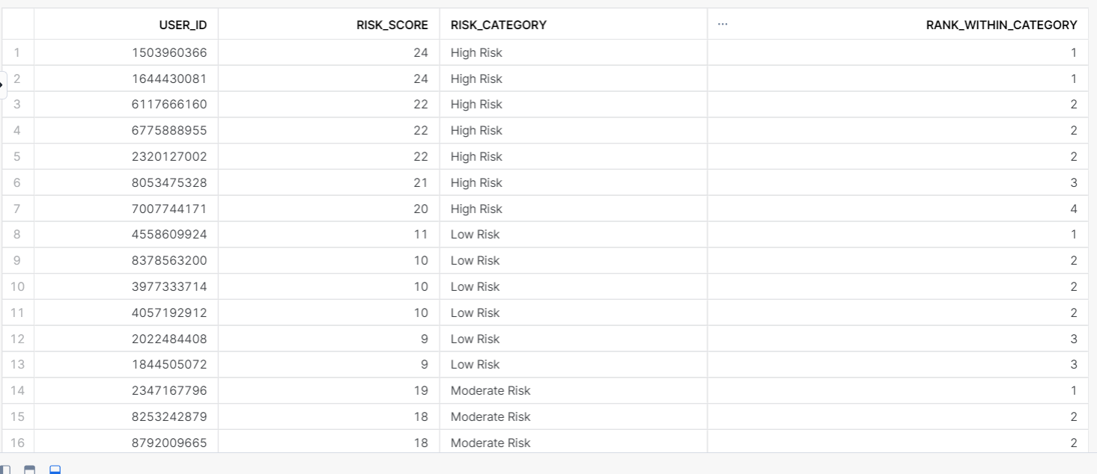
View: ranked_users_by_risk_category3
Code:
Output:
This directly supports our use case by categorizing users into different risk levels based on their health scores, allowing us to tailor insurance plans to each individual's specific risk profile. Additionally, ranking users within each risk category provides valuable insights into the relative risk levels among policyholders, enabling us to implement targeted interventions and adjust premiums accordingly to improve coverage, reduce costs, and promote well-being.

Slide 9
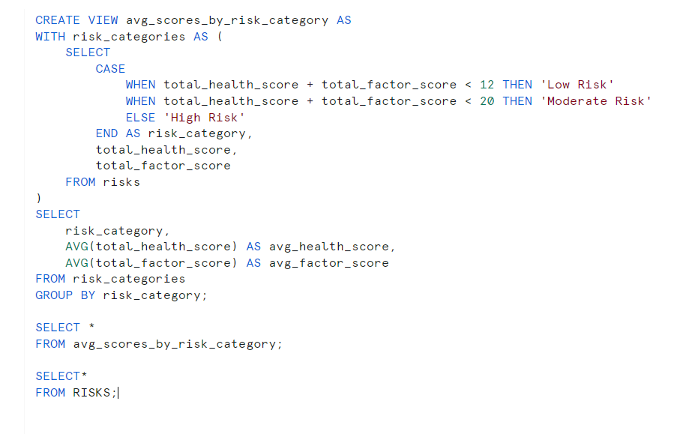
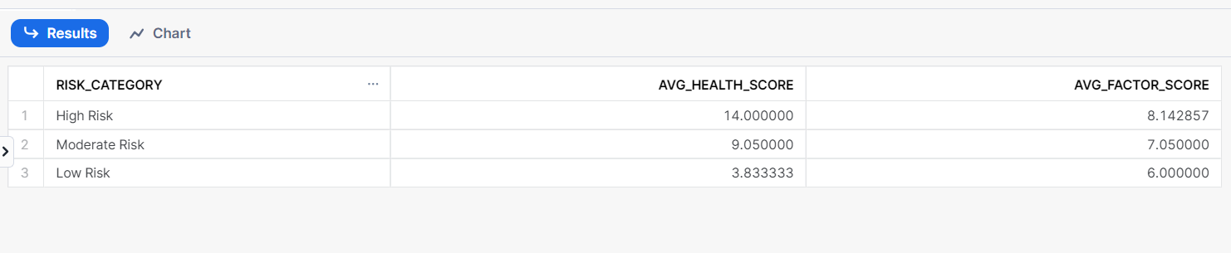
View: avg_scores_by_risk_category
Code:
Output:
The output provides an understanding of health and factor scores across different risk categories, indicating that higher-risk cases tend to have higher average scores compared to moderate or low-risk cases.
This view provides insights into the average scores for each risk category, helping to identify trends and patterns in the data.

Slide 10
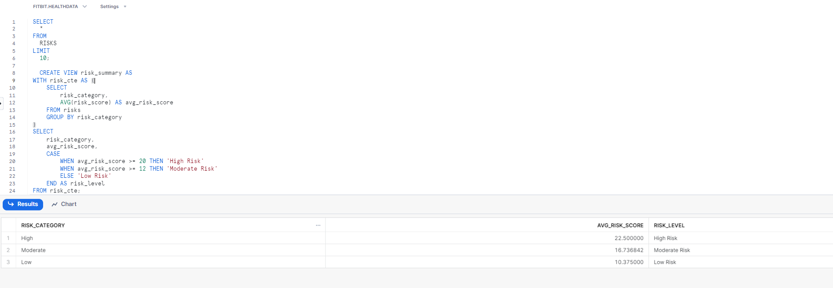
View and Output: risk_summary
This view provides a summary of average risk scores categorized by risk level, enabling your platform to offer personalized insurance plans tailored to individual health profiles. By analyzing these averages and categorizing them into 'High Risk', 'Moderate Risk', or 'Low Risk', we can dynamically adjust premiums and implement proactive health management strategies, aligning with the goal of improving coverage, reducing costs, and promoting well-being among policyholders.

